Slide 1
Name: Abdullah Ashfaq Department: BSCS SUBJECT: Data Structures and Algorithms Topic: HEAP
0334-3127215

Slide 2
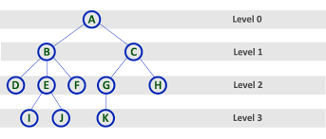
What is level of a tree

Slide 3
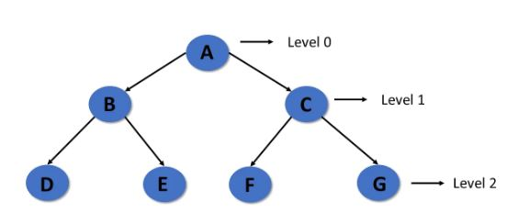
What is level of a tree

Slide 4
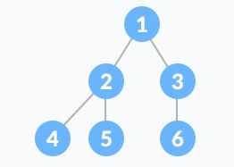
What is Complete binary tree
A binary tree is called complete binary tree when all the level of binary tree is completely filled except possibly the last level, which is filled from left side. In other words all the nodes are as far left as possible in complete binary tree.

Slide 5
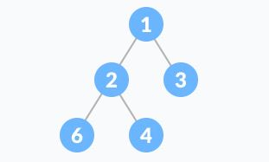
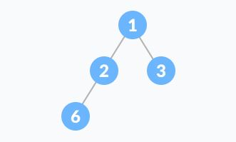
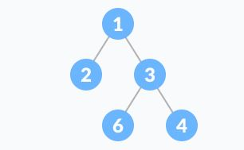
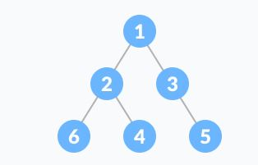
Checking COMPLETE BINARY TREE

Slide 6
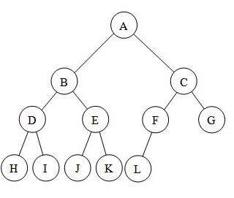
COMPLETE BINARY TREE

Slide 7
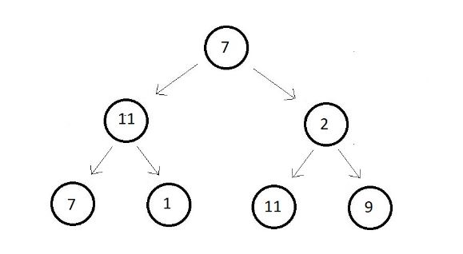
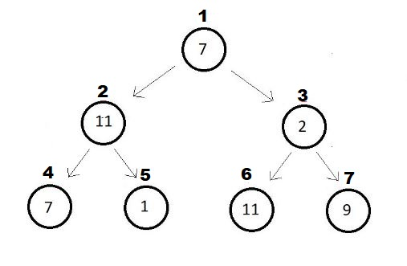
Giving INDEX to the nodes of a tree

Slide 8
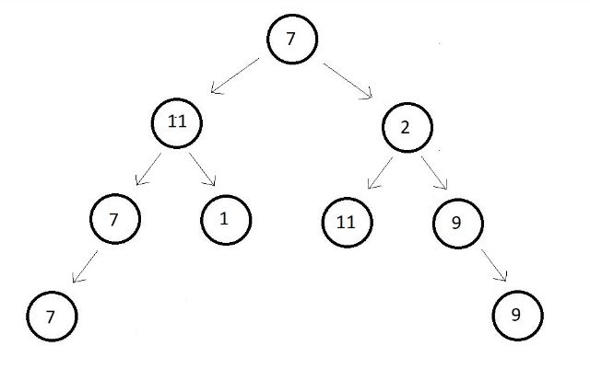
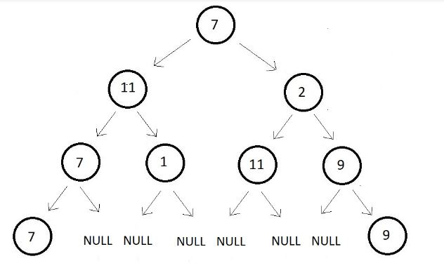
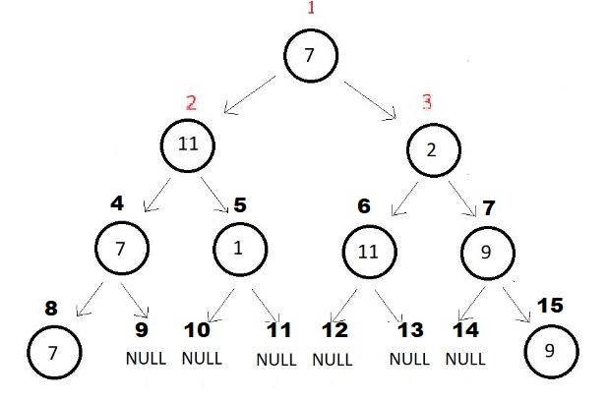
Giving INDEX to the nodes of a tree

Slide 9
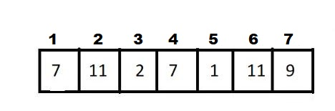

ARRAY REPRESENTATION OF a TREE
Here if n is the index number of a node then $\frac{n}{2}$ is the parent of that node.
Just because of this formula, we’ve started the array with 1 index.

Slide 10
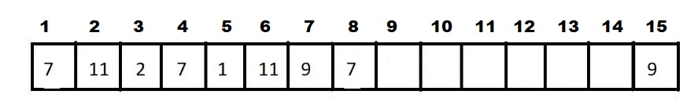
ARRAY REPRESENTATION OF a TREE
Remember that a complete binary tree doesn’t have any gap in its array representation.

Slide 11
WHAT is HEAP
A Heap is a special Tree-based data structure in which the tree is a complete binary tree and all the nodes of the tree are in a specific order.
TYPES OF HEAP
Min Heap
Max Heap

Slide 12
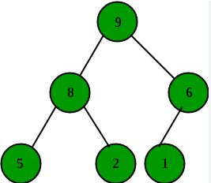
MAX HEAP
A max heap is a complete binary tree in which the value of a node is greater than or equal to the values of its children.

Slide 13
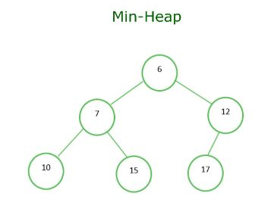
Min HEAP
A min heap is a complete binary tree in which the value of a node is less than or equal to the values of its children.

Slide 14
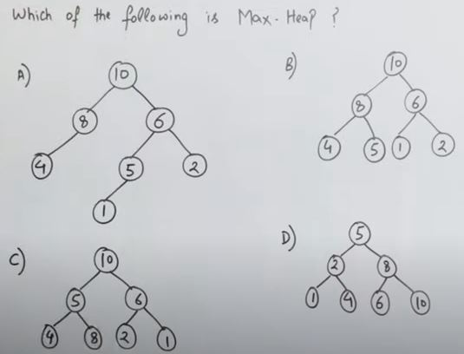

Slide 15
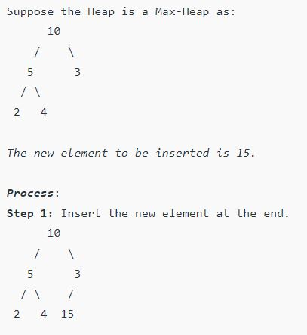
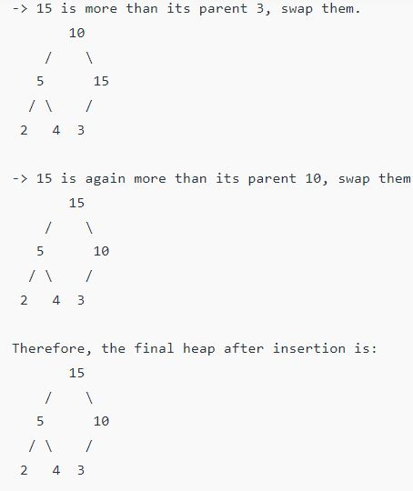
INSERTION in MAX HEAP
Always insert in the last index.

Slide 16
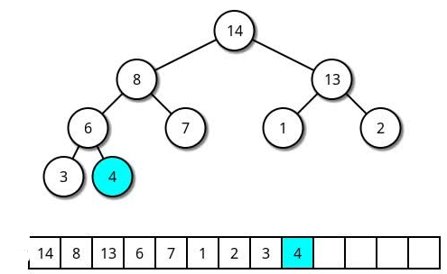
TRY TO INSERT 9

Slide 17
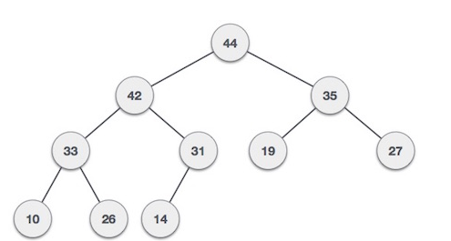
TRY to insert 50

Slide 18
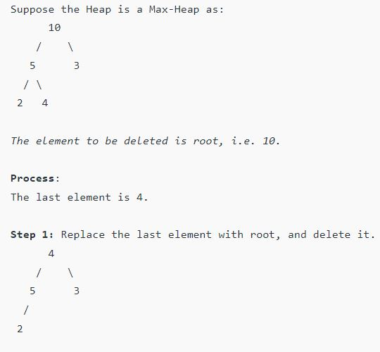
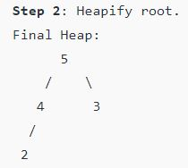
DELETION in MAX HEAP

Slide 19
TRY to delete 9

Slide 20
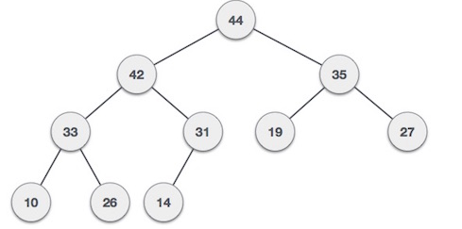
TRY to delete 44

Slide 21
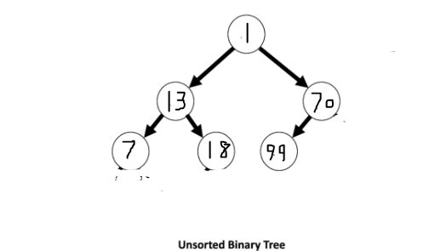
WHAT is HEAPiFY
HEAPiFY is the process of creating a heap data structure from a binary tree

Slide 22
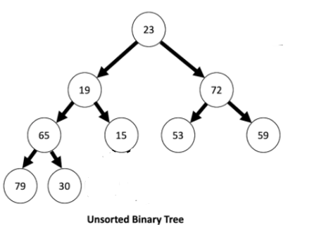
WHAT is HEAPiFY
HEAPiFY is the process of creating a heap data structure from a binary tree

Slide 23
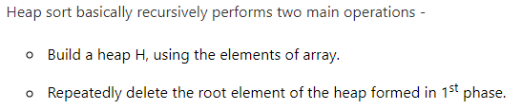
HEAP SORT

Slide 24
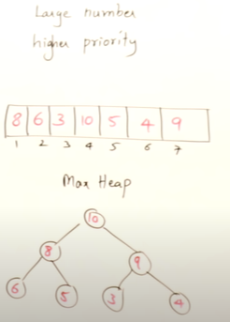
HEAP As priority Queue

